Slide 1
Trade in a Green-Growth Development Strategy:
Global Scale Issues and Challenges
Jaime de Melo
FERDI and UNIVERSITY of Geneva
28^{èmes} Journées du développement ATM , 12-13 Juin 2012

Slide 2
Four Roles for Trade in Climate Change Mitigation
Portfolio of green technologies carbon-free necessary Will require huge R&D effort (private and public). For which open WTS is needed to diffuse technological progress
Enforcement mechanism for IEAs on GPGs, e.g. Montreal Protocol= Entice participation (deter ‘free-riding’)
Trade measures to correct for carbon leakage (aka ‘pollution haven’ effect resulting from loss of competitiveness of exports). (border tax adjustments)
Large differences in abatement costs: separate where abatement takes place from who pays the costs (carbon-credit trading system as in e.g. ETS).
…but green growth is more than climate..
Notes:
Linking trade and environment agreements.
No advantage if polllution is purely local. When pollution is global there are efficiency advantages at linking as better enforcement is possible due to wider range of incentives and punishments and opportunity for trade offs across issues. Possible but trade would be less free than without linkage.
The more important problem with trade sanctions as enforcement mechanism is that it is poorly targeted as the externality is not bilateral.

Slide 3
…Caveats
Linking Trade and Environment Agreements?
No advantage if polllution is purely local.
When pollution is global there are efficiency advantages at linking as better enforcement is possible due to wider range of incentives and punishments and opportunity for trade offs across issues.
…. but trade would be less free than without linkage.
The more important problem with trade sanctions as enforcement mechanism is that it is poorly targeted as the externality is not bilateral

Slide 4
Outline
Channels of Interaction
Direct Trade-Related Linkages
By-product externalities
Pattern of Production
Climate:Pollution-Havens, Trade Leakages and BTAs
Pollution Havens?
Climate Change Mitigation, Leakages and BTAs
Implementation Difficulties: Political Economy Considerations
Selecting a BTA: Steel Case
Failure at Doha on fisheries
Failure at Doha on Environmental Goods and Services (EGS)
Concluding Remarks
Notes:
Paper is mostly taxonomic.
Emphasis on selected estimates

Slide 5
Channels of Interaction
(a) Direct Trade Environment Linkages
(b) by-product externalities
(c) Pattern of production
Environmentally Preferable Products (EPPs)
Goods for Environmental Management (GEMs)
Tradable Environment-Related Products
Other Products
Production by-product externalities
•Local/Regional:( SO2) •Global:( GHGs,CFCs)
(c)
(b)
X = F(K,V, NRP, θ_{X})…(a)
E =G(X,T,Y, θ_{E}) (b)
T =H(NRC,NRP, E(T), θ_{T}) (c)
•Transport emissions
•Resource depletion
•disease/Invasive Species /ecological diversity
(a)
Natural Resources in consumption (NRC) Natural Resources in production (NRP)
Species, genetic resources, scenery
Non renewable Renewable
Fuels,
Mineral products
Forestry products, Fresh water

Slide 6
Climate: Pollution Havens, Trade Leakages, and Border Tax Adjustments (BTAs) (i)
Pollution Havens?
Energy-intensive sectors are weight-reducing = Not footlose (not much world-wide leakage for SO2 over period 1990-2000). Relevant for CO2?
Small pollution haven effects in bilateral trade (strong composition effects as NN dominates NS trade so PCI is not much affected by environment policies)
Factoring in FDI--mostly directed to EPZs likely to lead to cleaner exports (supporting evidence from China).
…but ‘virtual trade in carbon’ (see next slide)
Notes:
Let pollution industries migrate
----Start with HO model with two countries, N and S and PCI_{NS} is the pollution content of imports of N from S. Two products, one clean one dirty. Due to stricter environmental policy of N, S has comparative advantage in dirty with PCI_{NS}>0 and PCI_{SN}=0. Globalization will increase PCI_{NS} according to PH hypothesis. Effect mitigated by a factor endowment (FE) effect if dirty is k-intensive and N is well-endowed in capital. PHH verified if PH dominates FE. Following slides show that for most of 10 pollutants PH is negative and FE positive, but far from always and, more importantly that adding the two together the overall effect is that the PCI of trade is anything but driven by the PHH (which has dominated much of the debate in the Trade and Environment literature. In HO model, FDI will shift comparative advantage in dirty towards S (which uses more dirty technique) and hence increase PCI_{NS}.
---Next bring in outsourcing with a continuum of goods (Feenstra-Hanson (2006). As shown by Dean and Lovely (2010), FDI that goes towards exporting activities (as in the case of China where much FDI goes to export-processing zones) will lower the cost of capital leading S to shift production of activities towards less pollution-intensive goods. Evidence in China for the pollution content of exports over 1995-2004 is coherent with this framework.

Slide 7
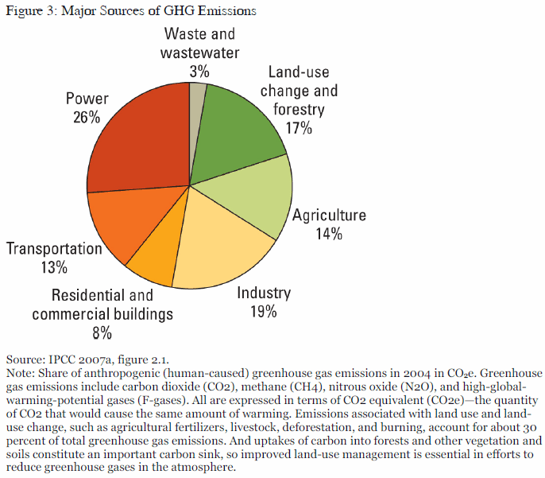

Slide 8
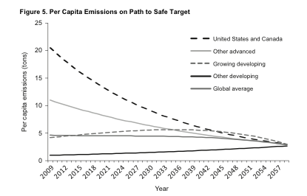
Paths to a ‘safe’ Target (converge to +2⁰ with equal PCE)

Slide 9
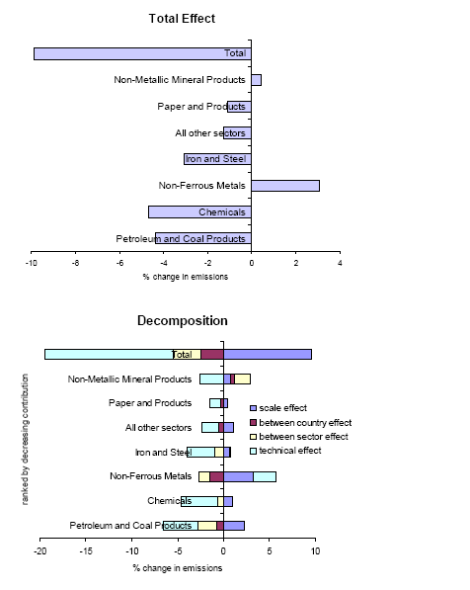
Decomposition of SO2 emissions: 1990-2000 (Grether et al. 2011)
Counterfactual: Produce consumption bundle without trade
Opening to trade:
emissions up by 10% in 90
emissions up by 3.5% in 2000
= supports pollution-haven view
…but more important are emissions related to international transport= Account for 5-9% of total mfg. emissions
Adding trade-related transport activities + composition effects
→ Mfg. emissions up by 15%
Total= -9.8% Scale =9.5%
Tech.=- 14.0%
w/n=-3.0%
b/w=-2.4%
9
9
9

Slide 10
Pollution Content of Imports (PCI): N=48; 79 3-digit industries (Grether et al. 2012)
TOT is the sum of the FE and PH effect expressed as a percentage of the PCI attributed to the fundamental determinants of bilateral trade.
Notes:
PH evidence for 10 pollutants:
----Sample of 48 countries for 79 3-digit industries for each one of 10 pollutants to estimate bilateral trade and the PCI of imports in a gravity framework, decomposing the total PCI into three components: a “deep” determinant (normalized to one) captured by the traditional variables in the gravity model (distance and dummy variables) unrelated to differences in endowments and to differences in environmental policies. Control for endogeneity of environment policy (captured by the lead content of gasoline, but have to use US emission coefficients---except for SO2.
---figure above decomposes the contribution of the PH and FE effects to the total PCI where for each pollutant. The total (TOT) PCI is given by 1+TOT= (1+FE)(1+PH) where “1” is the share of PCI that is unrelated to differences in environmental policies or to differences in endowments.
As expected, the PH effect is almost always positive and the FE effect is negative. For four out of 10 pollutants the PHH is vindicated.
..but the net contribution of these effects is always small, between 5% and 10% of the total effect
Even though the FE and PH effects are important in North-South (NS) and SN trade, much trade is accounted for by intra-regional NN trade among Northern countries. However, with increase in SS trade in recent years, the contribution of the PHH to the PCI would be expected to increase.
Note that by concentrating on one country, usually the US (e.g. Ederington et al. (2005)), previous estimates were not really testing the hypothesis.

Slide 11
The Declining Pollution Intensity of China’s trade (Dean and Lovely (2010))
Processing trade (i.e. EPZ trade) is less pollution-intensive than traditional trade. Coherent with Feenstra-Hanson model. With trade in intermediates, FDI leads to less pollution as cost of capital ↓ → shift along continuum towards production of less pollution-intensive intermediates
Notes:
---Next bring in outsourcing with a continuum of goods (Feenstra-Hanson (2006). As shown by Dean and Lovely (2010), FDI that goes towards exporting activities (as in the case of China where much FDI goes to export-processing zones) will lower the cost of capital leading S to shift production of activities towards less pollution-intensive goods.
Panel estimate evidence in China (1995-2004) ---in first-difference that control for endogeneity of the share of processing trade in overall trade and other factors (capital intensity, labor intensity, income, tariffs, barter terms-of-trade) --- is coherent with this framework. Pollution-intensity is inversely correlated with the share of processing trade. While the sample is small (36 observations), their results support the importance of several channels in the debate.
Kuznets effects appear to be significant (lower pollution intensity is associated with income growth).
Tariff reductions (entry into WTO and a decline in tariff protection of 75 percent) are positively associated with reductions in the pollution intensity of exports.
Results also support the role of FDI in reducing the pollution-intensity of Chinese trade. The pollution intensity of exports is lower the larger the share of processing exports and the larger is the share of FDI in total investment.
This suggestive evidence could reflect fhat, over the period, foreign investors brought greener technologies than their local counterparts.

Slide 12
‘Virtual Trade’ in Carbon (Peters et al. 2011)
Notes:
Throughout the Kyoto Protocol (KP) negotiation period (1990-2008), CO2 emission transfers from developing to developed countries through trade were 1.2Gt, an estimate that exceeded the target KP1 emission reductions .
→ Annex B countries have continued to contribute to the growth in emissions. Any cap on emissions should be on consumption not ‘territorial based’ as under KP1.

Slide 13
Net Change in Territorial Emissions (1990-2008) (Peters et al. 2011) Why caps should be consumption-based, not production-based
13
KP pledge
Source: Peters et al. (2011, figure 3)
Note : Estimates exclude emissions related to
land-use change.
Annex-B are the developed countries
participating under KP.
Emission transfers between Annex-B countries have
been removed. Europe represents Annex-B EU-27
plus Croatia, Norway, Switzerland.
(*) Shows pledges for reduction under KP
(including non-signatory US).
All annex B countries are importers of emissions,
mostly from China.
Positive changes in transfer values represent
net importers of emissions.
…but not the US
Europe met KP-1 production target…so long as one does not count net CO2 embodied in trade
13
13
13

Slide 14
Leakage and Border Tax Adjustments: Simulation Estimates (I) Multi-regional General equilibrium (MR-GE) estimates
All results are largely driven by strong Terms-of-trade (TOT) effects (due to ‘Armington’ assumption).
Participation decision (Dong and Whalley (2010): Linkage via trade (i.e. TOT improvements from reduced consumption) increases participation decision but damage from +5 deg. has to be about 5 times larger than Stern estimates to get participation. BRICs would need compensation of $150 billion per year to cover estimated abatement costs.
Leakage. BTAs can reduce leakage rate by half (inefficiency because of strong TOT improvement from BTA leading to leakage). EX (Rutherford et al. 2010):
Individual cut of emissions by US or EU Leakage rate= 35%
Joint reduction by EU and US, Leakage rate = 20%

Slide 15
Leakage and Border Tax Adjustments: Simulation Estimates (II) Multi-regional General equilibrium (MR-GE) estimates
Effects of tariff on CO2 content. First-order effects of a $50/ton CO2 tax on all regions:
=10% export tax on China; EU=1.2%; US=3.1%
Trade effects of emission reductions of industrial countries= 17% via
Applying CO2 tax = developing countries exports = 2%;
BTA based on carbon-content of imports = developing countries exports  by 15%
Notes:
Developing countries would like to keep MFN…i.e. no border tax

Slide 16
Political Economy of Implementation (I)
Consensus that a tax of 100$ per ton of CO2 necessary to stabilize rise in temp. = 1$trillion rents per year up for capture by lobbies !!!
Biofuels: In US, 200 support measures per year costing $6billion+ 46% tariff on imported ethanol to protect infant-industry (=agriculture); EU 43% on imported ethanol
164 sectors/subsectors submitted to EU for «significant threat of carbon leakage»
→ Free license allocation under ETS.

Slide 17
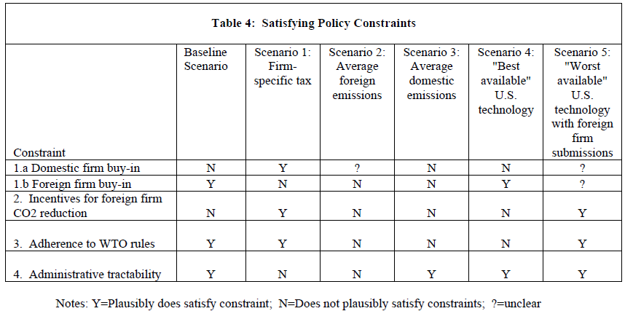
Which Border tax adjusments (BTA) Steel case (Moore, 2010)
Implementation Difficulties: Further Political Economy Considerations
17
None among BTA adjustments possibilities meets the 4 constraints for being implementable
Notes:
A tax of $100 per ton of CO2 will be necessary to keep temperature rise to around 2^{0.} This will generate annual rents close to a trillion dollars
Annual fossil fuel subsidies that should be eliminated about $300 billion.
These estimates are of an order of magnitude never seen in the international system.
Acting on both measures continues to face strong opposition and any serious action against climate change will have to face up to contestable rents far beyond those that have ever been at stake in the world trading system.
Moore’s case study for steel shows that none of the 5 contemplated scenarios for a BTA on steel would meet the 4 implementation constraints listed here.

Slide 18
The Cap and Trade System
18
If «independence property» holds, efficient allocation regardless of initial allocation of permits, but gov'ts who allocate licenses are not cost minimizers.
CAT worked relatively well under US Clean Air Act of 1990 as SO2 emissions were cut in half in the US 990-2000 with distribution of ‘bonus allowances’ to get bi-partisan support. Costs decreased by 50% relative to pure cap due to the possibility to trade licenses
Has not worked well internationally with fight over rents in the EU ETS (and proposed regulation on emissions from airplanes)

Slide 19
The Doha «no-Mandate » effects(I)
The subsidy problem (fossil fuels, water….and fisheries "Non-actionable). Huge problem for a green growth development strategy.
Can this be fixed at WTO? Or should it be in another international organization (World Climate organization?)
Doha Art. 28. mandate on fisheries «..participants shall also aim to clarify and improve WTO disciplines on fisheries subsidies…»
No agreement partly due to S&DT….yet fish are «more visible» than climate…
Notes:
Conclusion: S&DT (special and differential treatment) a real obstacle to progress …and it does nothing on goods trade….

Slide 20
Stalemate on Article 31 Negotiations
Two categories of EGs
Goods for Environmental Management (GEMs)
Environmentally preferable products (EPPs)
Problems identifying EGs
Multiple-end use for GEMs
Relativism, attribute disclosure, ‘like products’ for EPPs
Common Problems to GEMs and EPPs
No coverage in HS nomenclature
Lock-in

Slide 21
Identifying/Classifying Goods Related to Preservation and Management of the Environment
lawyers’ paradise, economists’ nightmare
Goods for Environmental Management (GEM) (Pollution, Resources)
Multiple end-uses
Environmentally Preferable Products (EPPs):
Single use
Production
-- Aluminium (Prebake vs Soderberg)
-- Organic cotton vs conventional cotton;
Use
-- Solar stoves
-- Solar furnaces
-- Energy efficient
consumer goods
Disposal
--- packaging (glass vs. plastic)
--- Cotton fiber versus synthetic fiber
Identification of use
Project Approach
Finer/alternative HS-classification problematic
Identification
Relativism: to the frontier (static and dynamic)
Attribute Disclosure (requires an efficient disclosure mechanism (e.g. certification and harmonization)
Processes and Production Methods (PPMs) and the like products at WTO
Difficulties to negotiate on agricultural products (e.g. biofuels) and environmental services
Lock-in if characteristics are embodied in HS code
No coverage in the HS (products and services)
21

Slide 22
WTO environmental Goods Submissions
Doha Article 31 mandate: Countries to come up with approach for identifying products for tariff reduction negotiations
Classification difficulties reflected in approaches:
(i) «list»
(ii) «Request and offer» (favored by some developing)
«Integrated project» (to deal with multiple-end use)
By 2008 13 countries lists ➔ 411 HS-6 codes with little overlap (see next slide)

Slide 23
… a decade later no agreement on a list
23
EGS= Environmental Goods and Services
Singles= 279 Duplicates =90 Triplicates= 35 Quadruplicates: 7
Note: «Friends» list includes 13 countries: EU, US, CAN,SWI,
2010: «start» negotiations on a core list of 26 goods

Slide 24
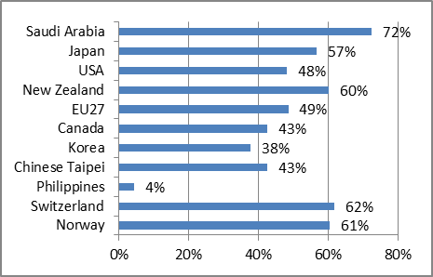
Correlates of EGs submissions
24
% of goods proposed under the 2008 CTESS program with Revealed Comparative Advantage (RCA>1)(in 2007)
Among the goods submitted by New Zeland (ie the 164 goods of the Friends’ list), 60% are goods for which it had a RCA in 2007
Source: Ballineau and de Melo (2011). Probit estimates for a sample of 380 submitted goods confirm that the probability of submitting a good to the EGS list is higher for goods with an RCA >1 and lower for goods with a high MFN tariff.

Slide 25
Patterns of Tariff Reductions …No mandate effect
25
No «mandate effect» as no acceleration in reduction of protection after 2001 relative to reduction in protection for other products
Especially for low-income countries
Next slide shows outcome under standstill

Slide 26
Conclusions (I)
Global Policy Making architecture (IMF, World Bank, WTO) needs overhaul to reflect strong physical linkages.
A regional approach (i.e. bottom-up approach à la Ostrom) more likely to give results (GATT with leeway more successful than WTO with SU)? EX: Environmental directives under Maastricht.
MFN + NT best compromise to face the threat of carbon tariffs and BTAs. Border tax adjustments have lower discriminatory capacity than contingent protection (developing countries want MFN, developed want NT).
Subsidy rules at the WTO need to be modified.

Slide 27
Conclusions (II)
Potential CO2 leakage effects probably exaggerated (for political economy reasons)…but BTAs looming on horizon as soon as we will get serious about climate
So far Countries did not act on articles 28 (fisheries) nor on art. 31 (EGS) of Doha mandate
lack of cooperation (exacerbated by CBDR+ S&DT)
Private sector initiatives more promising?

